Slide 1
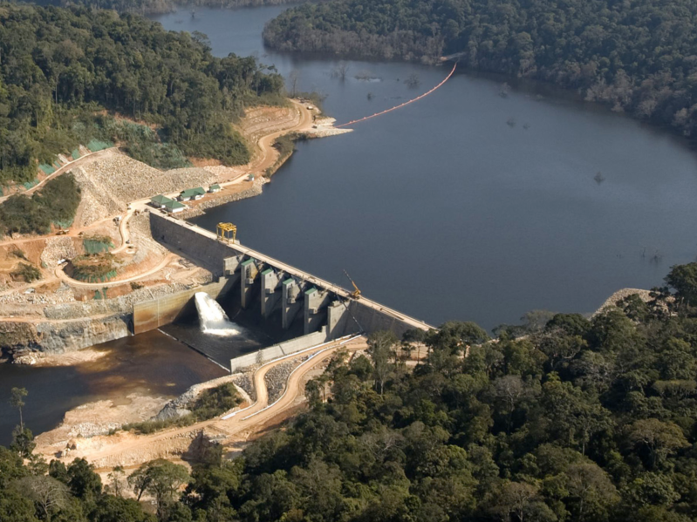



‘HPC and Uncertainty Treatment’
Examples with Open TURNS and Uranie
Presentation
A. Dutfoy
EDF R&D
EDF - PhiMeca - Airbus Group – Onera - IMACS - CEA
Prace Advanced Training Center
27-29 may 2019

Slide 2


Objectives and Principles
to present the methodology of treatment of uncertainty to the HPC community
  to get benefit of their knowledge on some HPC aspects specific to the Uncertainty Management
to apply the methodology to one simple case study: deviation of the free extremity of beam due to a load
using either OpenTURNS or Uranie
Content:
  Day 1: Presentation of the Methodology; Basics of Probability and Statistics; Presentation of Open TURNS and Uranie
  Day 2: Uncertainty Quantification Propagation and Ranking; OpenTURNS and Uranie
  Day 3: HPC aspects specific to the Uncertainty Management
Trainers: Consortium OpenTURNS and CEA

